Slide 1
Lecture 1: Science and Measurements
California State University, Fullerton
2023 Fall Semester – Chem 123

Slide 2
Outline
Introductions: Who Am I? And teaching philosophy
Review Syllabus
Calculator Use and Scientific Notation
Ch. 1: Science and Measurements
Classification and properties of Matter
Scientific Method – hypotheses, theories, and laws
Significant Digits
Dimensional Analysis

Slide 3
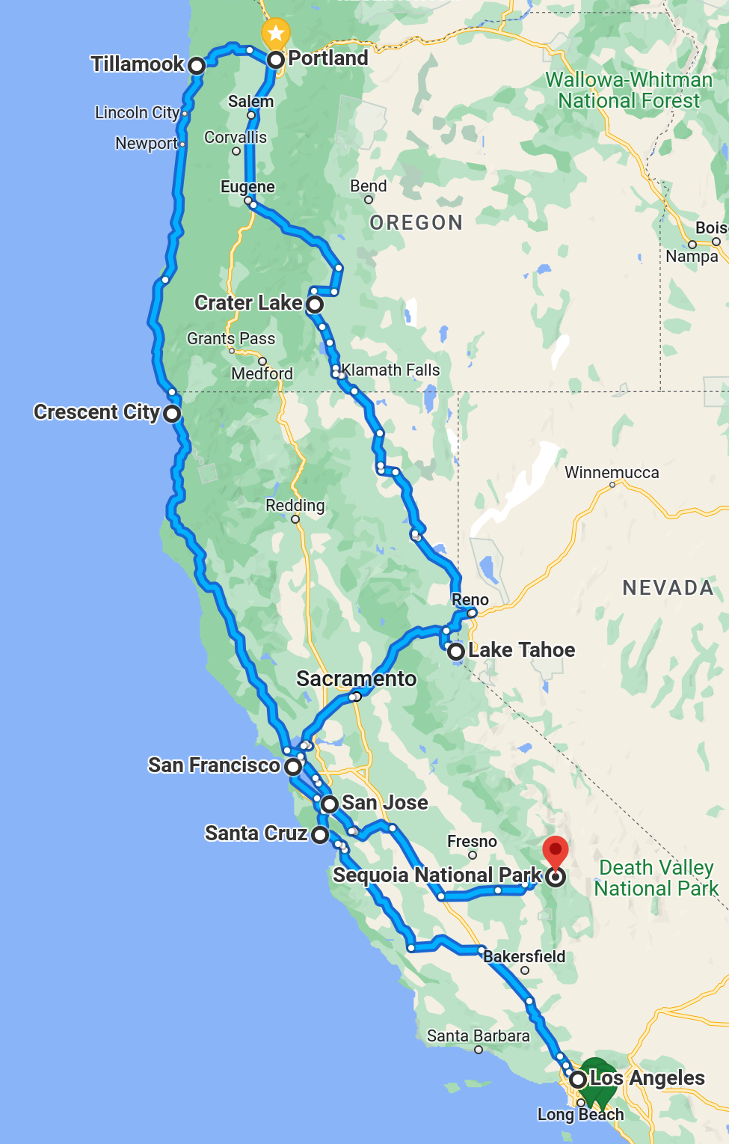
Who Am I?
Prof. Dr. Brian Nguyen
Graduated from UCI (both undergraduate and graduate) in June 2022
Went on 4,000 miles post-PhD road trip over a span of 4 weeks!
Enjoy swimming and incorporating weightlifting+running (Triathlon in the works)

Slide 4
Your Turn
My goal is to memorize everyone's name (~80 students) by the end of the semester
Write your name on one side of the 3x5 notecard
On the other side, write something I can remember you by.
Pass the notecard to the middle aisle and then forward to the front of the room (Ticket for attendance)

Slide 5
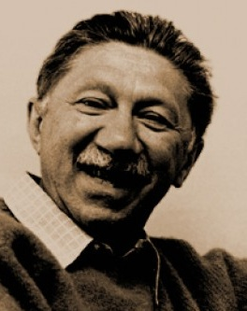
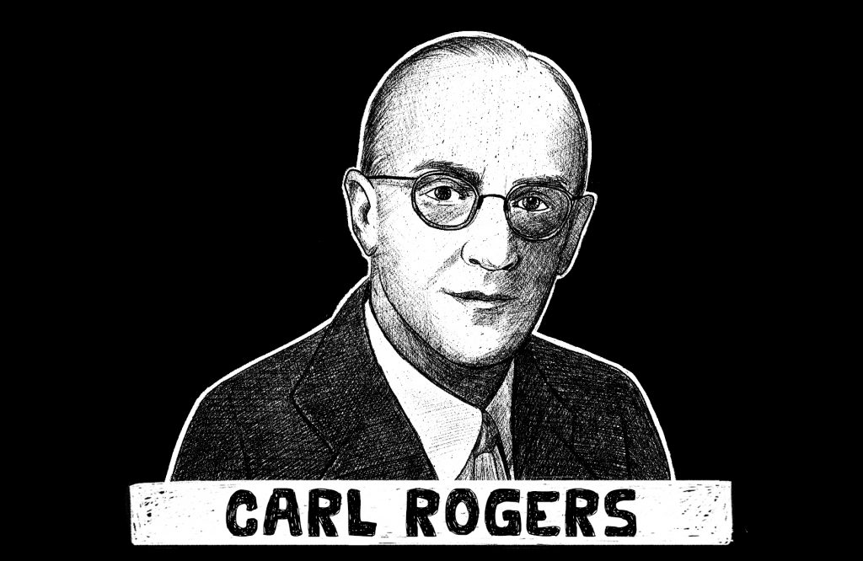
Teaching Philosophy
Student-teacher relationship is central
Mutual respect and growth
“Unconditional positive regard”
Awareness of the other and their thoughts/emotions
Teacher is coach/supporter/mentor rather than supervisor/boss
Focus on attitude and approach rather than content
Learning to fail
Collaboration rather than competition
Explore and experience something new together, learn about chemistry and ourselves
Abraham Maslow

Slide 6
Making the most of it
Questions to consider:
Why am I taking this course?
What would I like to achieve?
What methods/tools/resources work for me?
Your feedback, questions, participation are vital:
Attend lectures, if possible
Give on-going feedback to instructors through facial expression, chat, email, during office hours, etc.
Fill out evaluations (I am going to send out a canvas survey)
Own your education
Be proactive, do not hesitate to speak up or get help

Slide 7
email etiquette
Don't start an email with "Hey Professor" instead "Dear Professor" or "Hi Professor" or "Greetings Professor" or "Good morning/afternoon/evening"
Beginning, middle, and end – give me context
Requesting office hours appointment – tell me what do you need help with
Homework help – show the problem and your attempt
Make-up exams – tell me why you're missing the exam

Slide 8
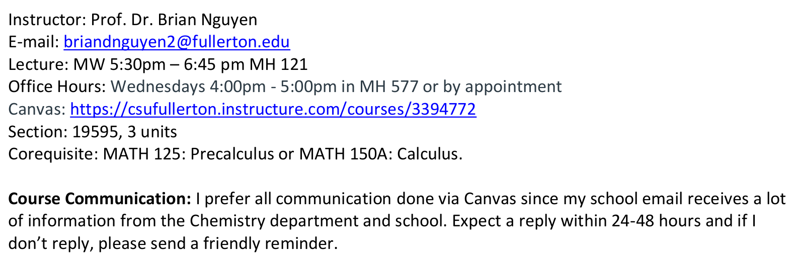
Syllabus

Slide 9
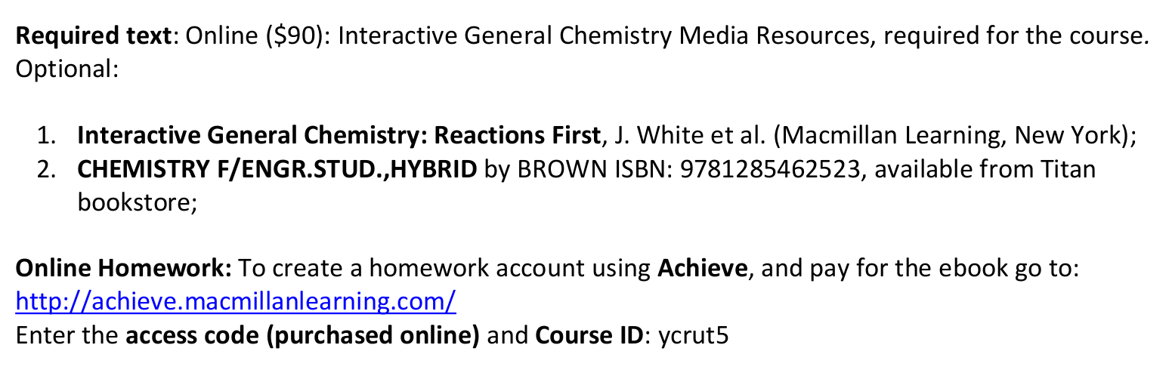
Syllabus

Slide 10
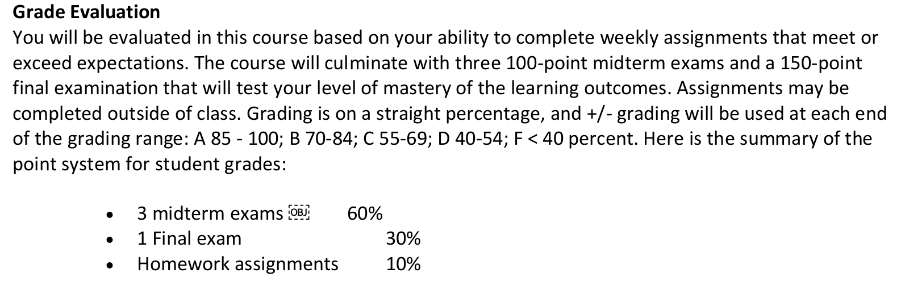
Syllabus

Slide 11
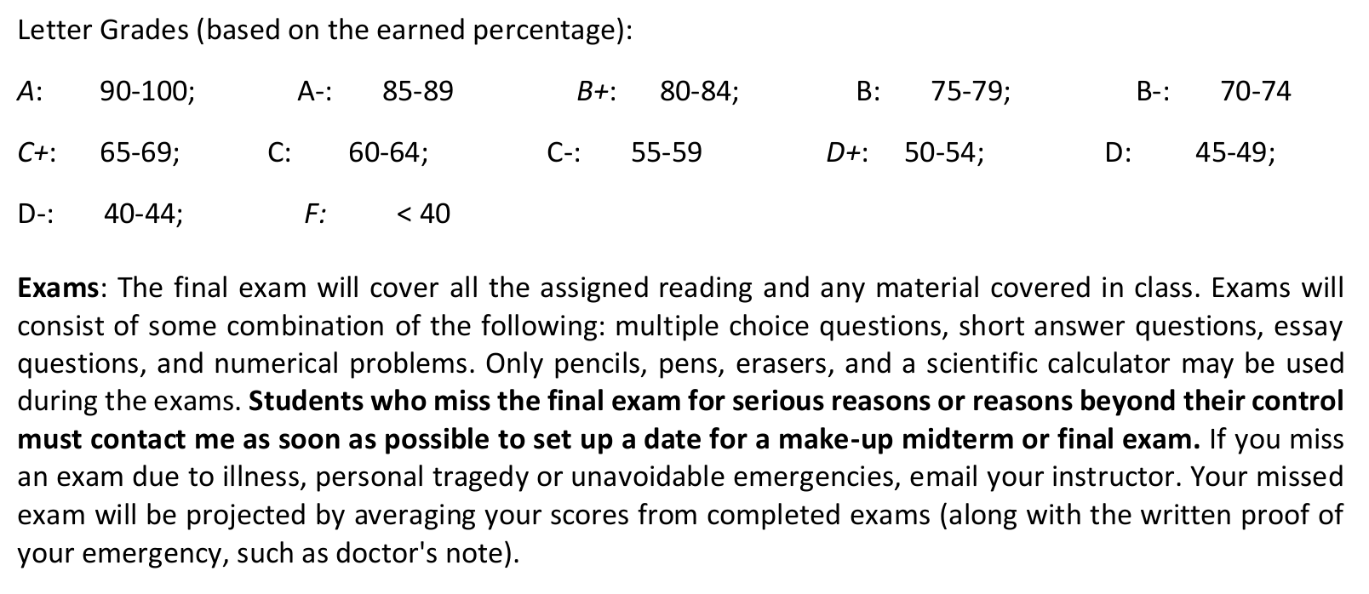
Syllabus

Slide 12
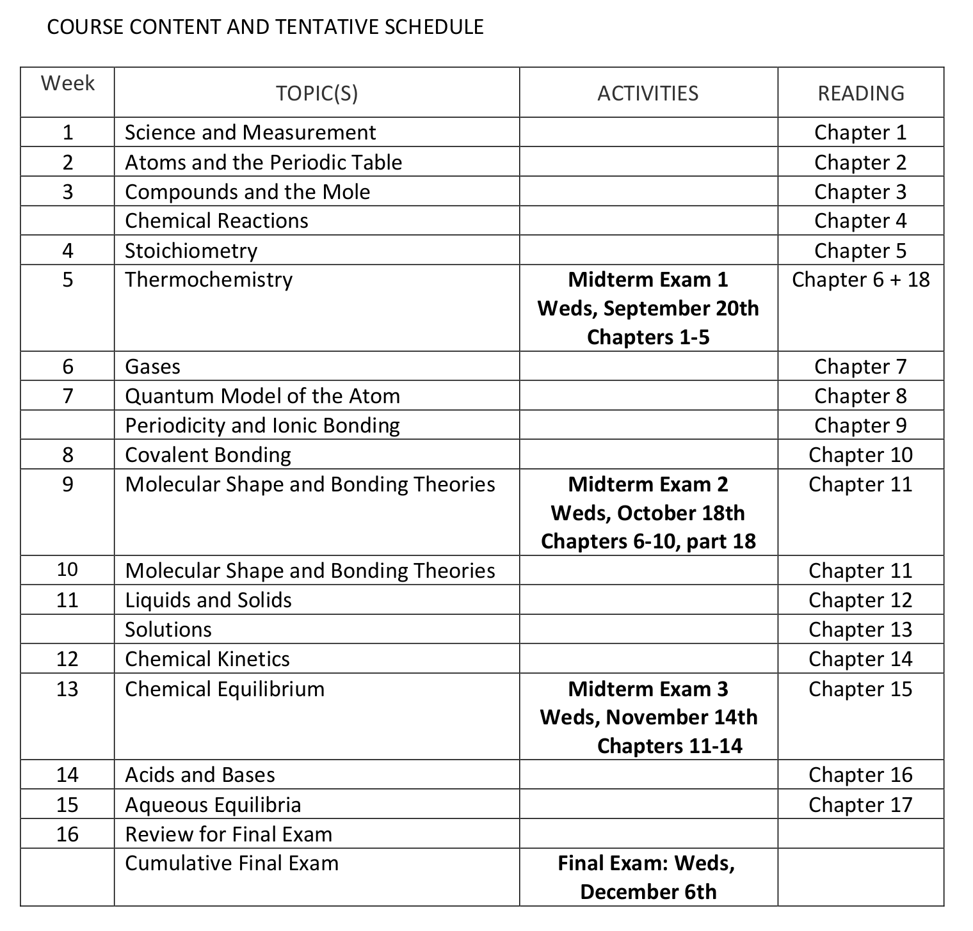

Slide 13
Outline
Introductions: Who Am I? And teaching philosophy
Review Syllabus
Calculator Use and Scientific Notation
Ch. 1: Science and Measurements
Classification and properties of Matter
Scientific Method – hypotheses, theories, and laws
Significant Digits
Dimensional Analysis

Slide 14
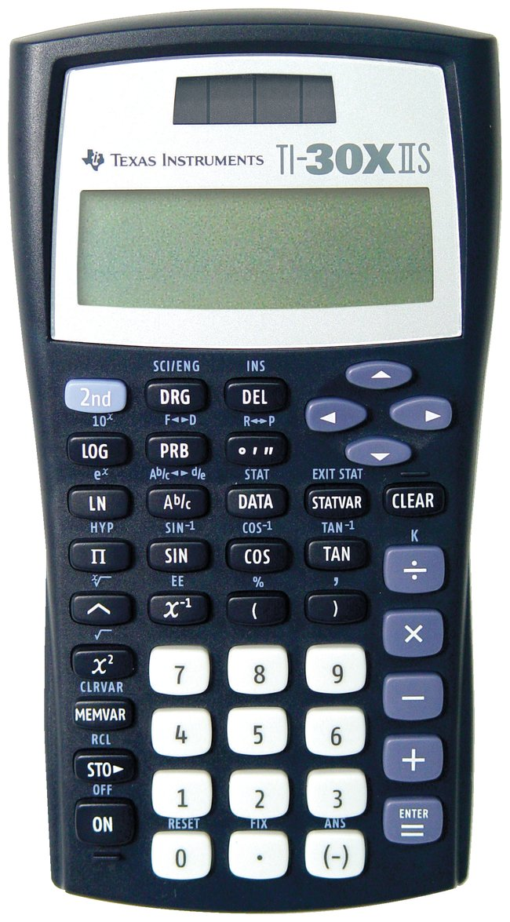
Calculator use and scientific notation
If you're using a graphing calculator, each student need to erase the memory (Google) on exam day
For intermediate steps, include as many digits to avoid rounding errors
Round answers at the end
Round up if the next digit is 5 or greater
Round down if the next digit is less than 5

Slide 15
Calculator use and scientific notation
Turn "on" and turn "off" press 2nd+on
Use "2nd" to use options in blue e.g. 2nd+x² -> √
"^" - indicates raising to some power
"( )" - use parentheses to enclose
10^(3-2) is not the same as 10^3-2
1/(3-2) is not the same as 1/3-2
"2nd+DRG" - scientific notation (SCI)

Slide 16
Calculator use and scientific notation
N = C × 10^{m}
N is a large number e.g. 1,000,325,910
C is coefficient between 1 and 10 –> 1 ≤ C < 10
m is the exponent
Examples:
0.00363246 = 3.63246 × 10⁻³
1,000,325,910 = 1.000325910 × 10⁹

Slide 17
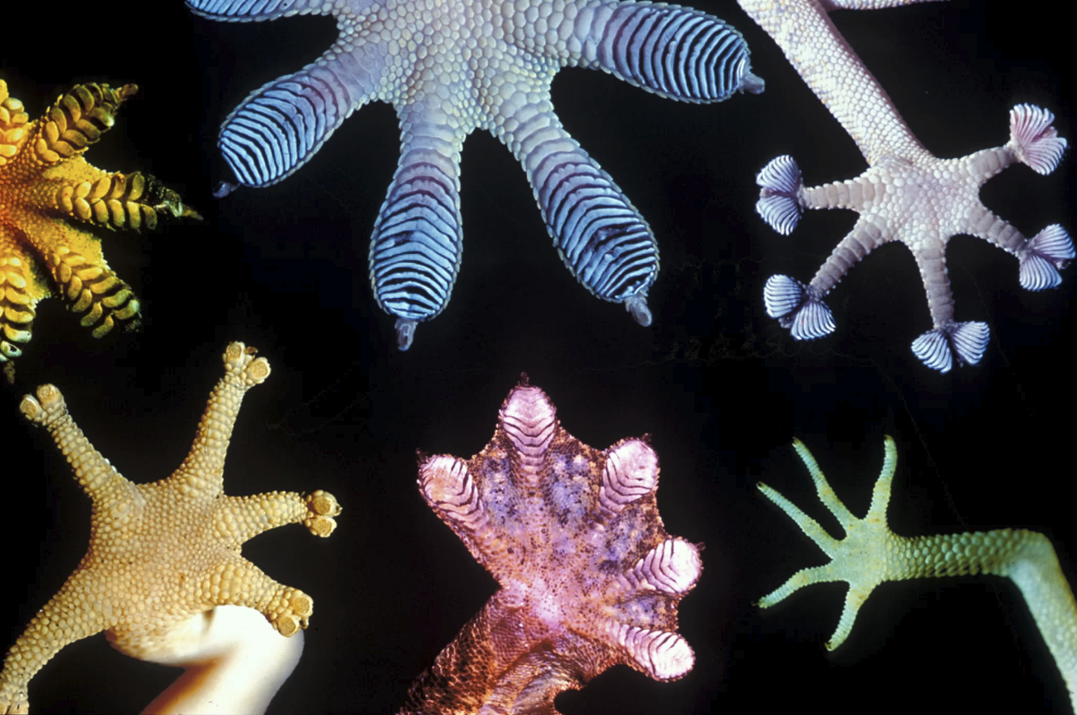
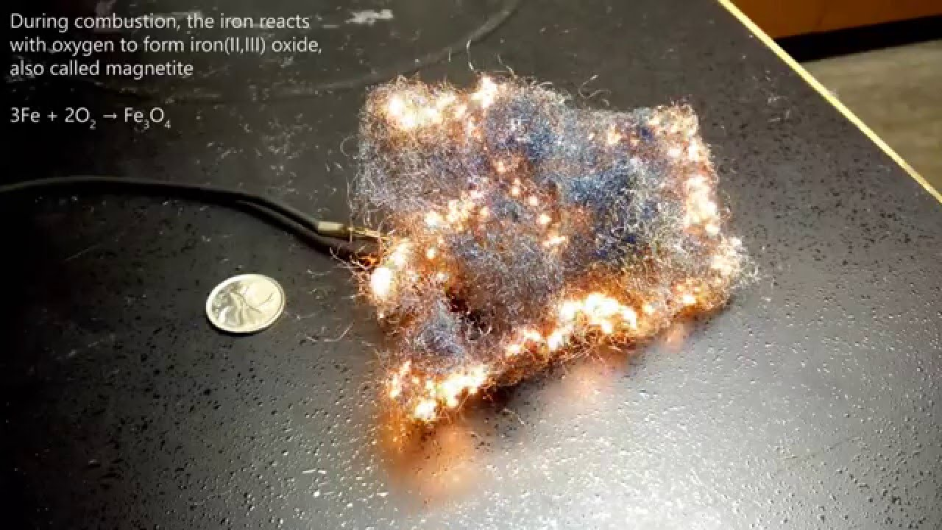
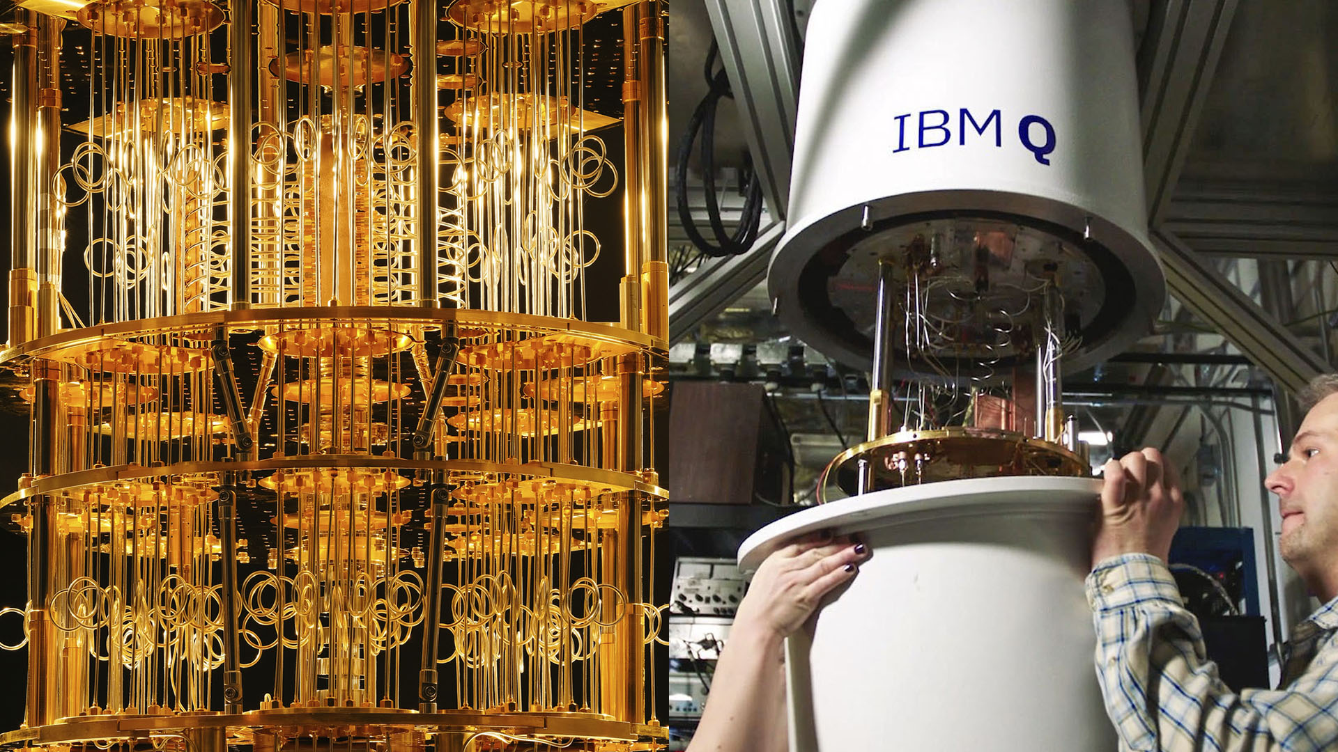
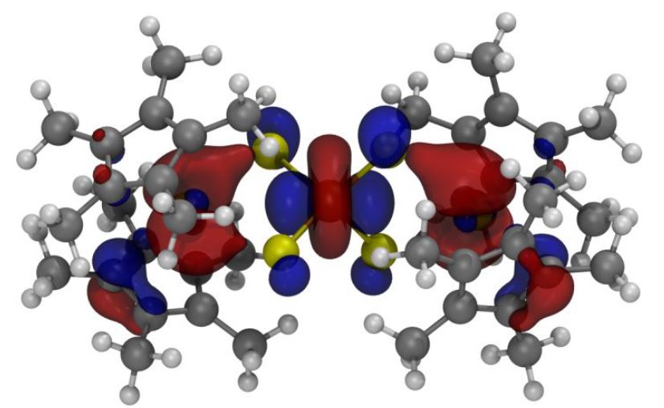
Chemistry: study of matter and energy
Gecko's feet
Combustion reaction
Quantum computing

Slide 18
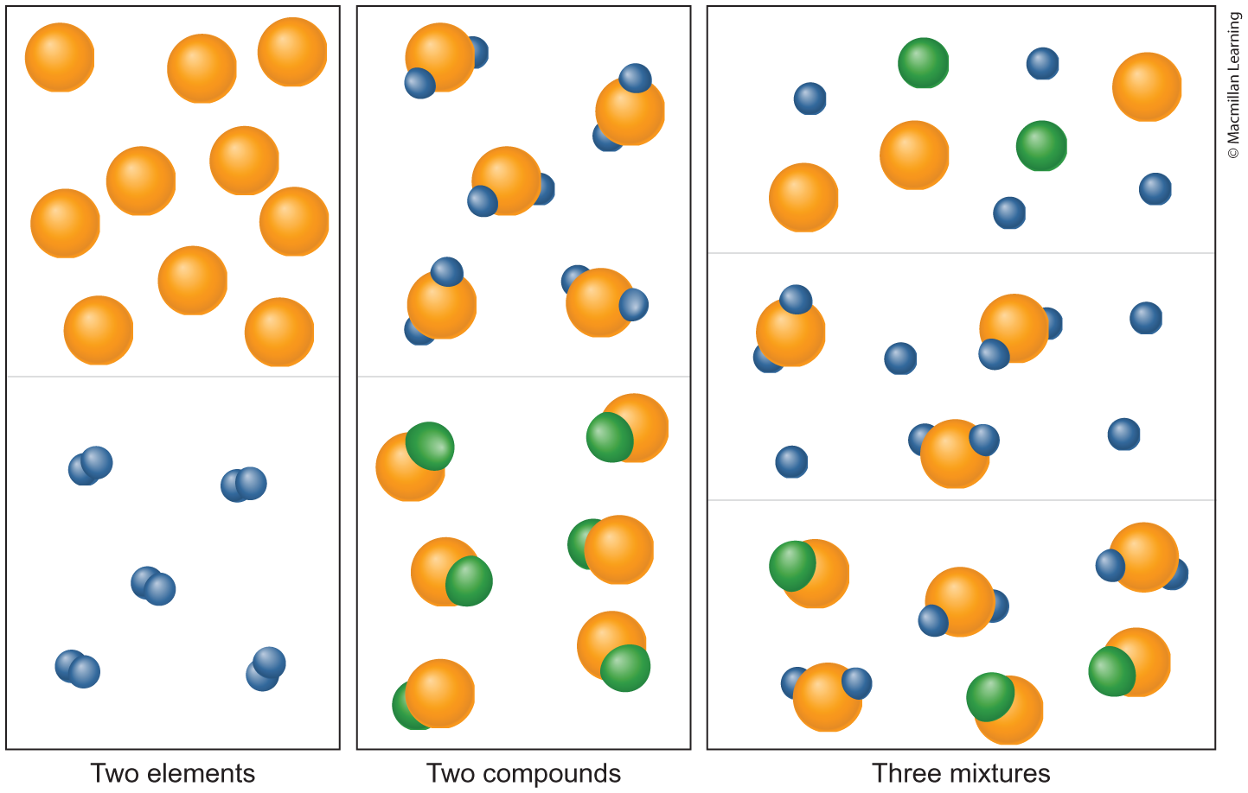
Classification of matter
Matter is everything with mass and occupies space
Compounds made of elements
Pure Substances v. Mixtures
Types of Mixtures
Heterogenous
Homogenous

Slide 19
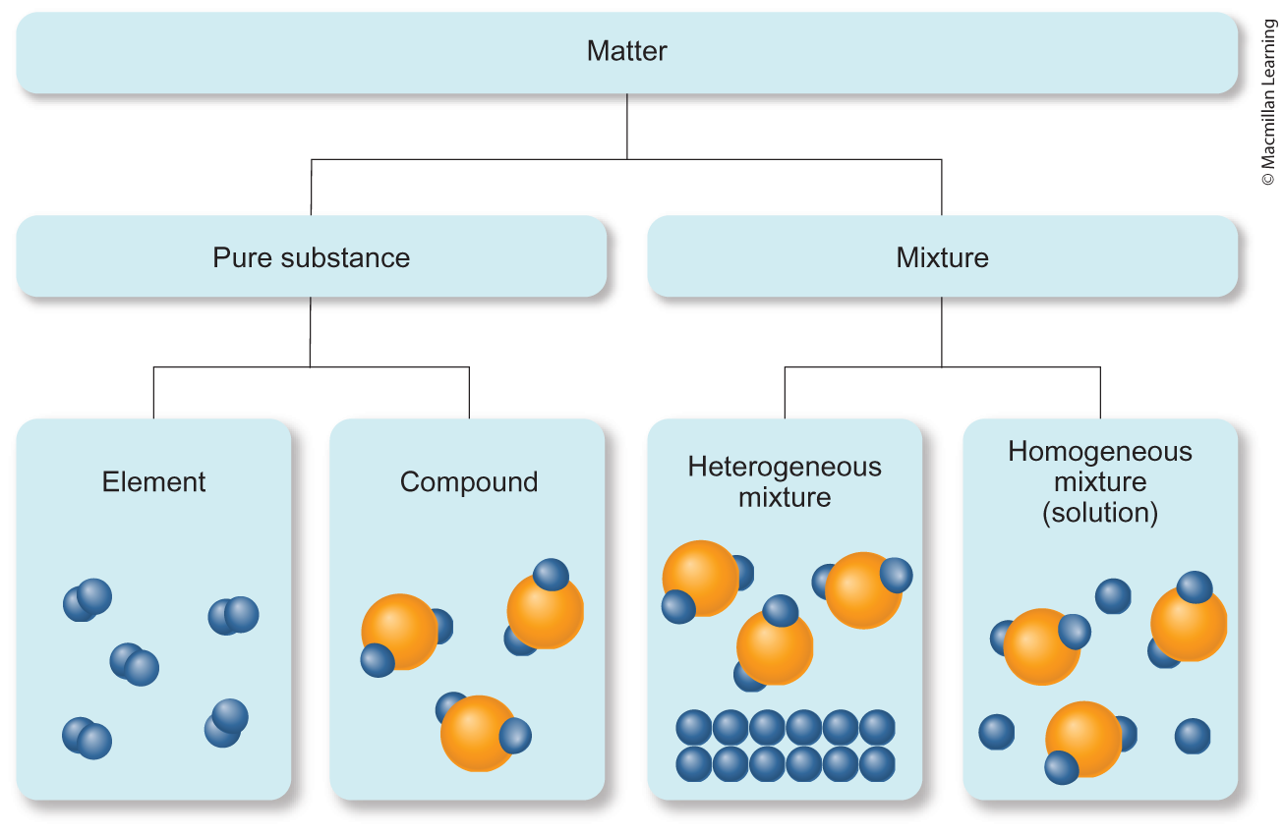
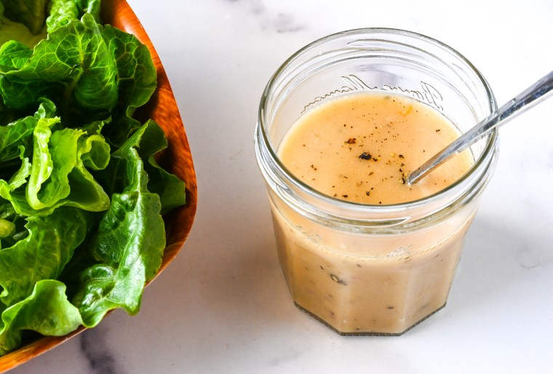
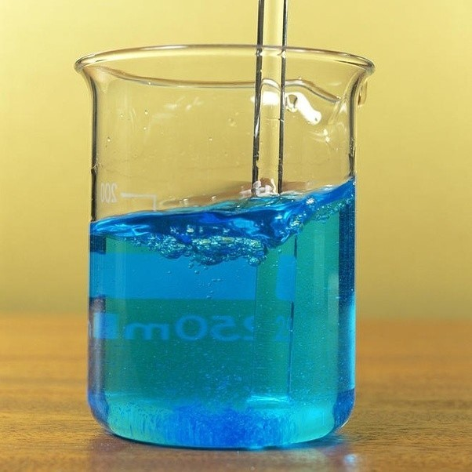
Classification of matter
Salad dressing
Copper(II) Sulfate Solution

Slide 20
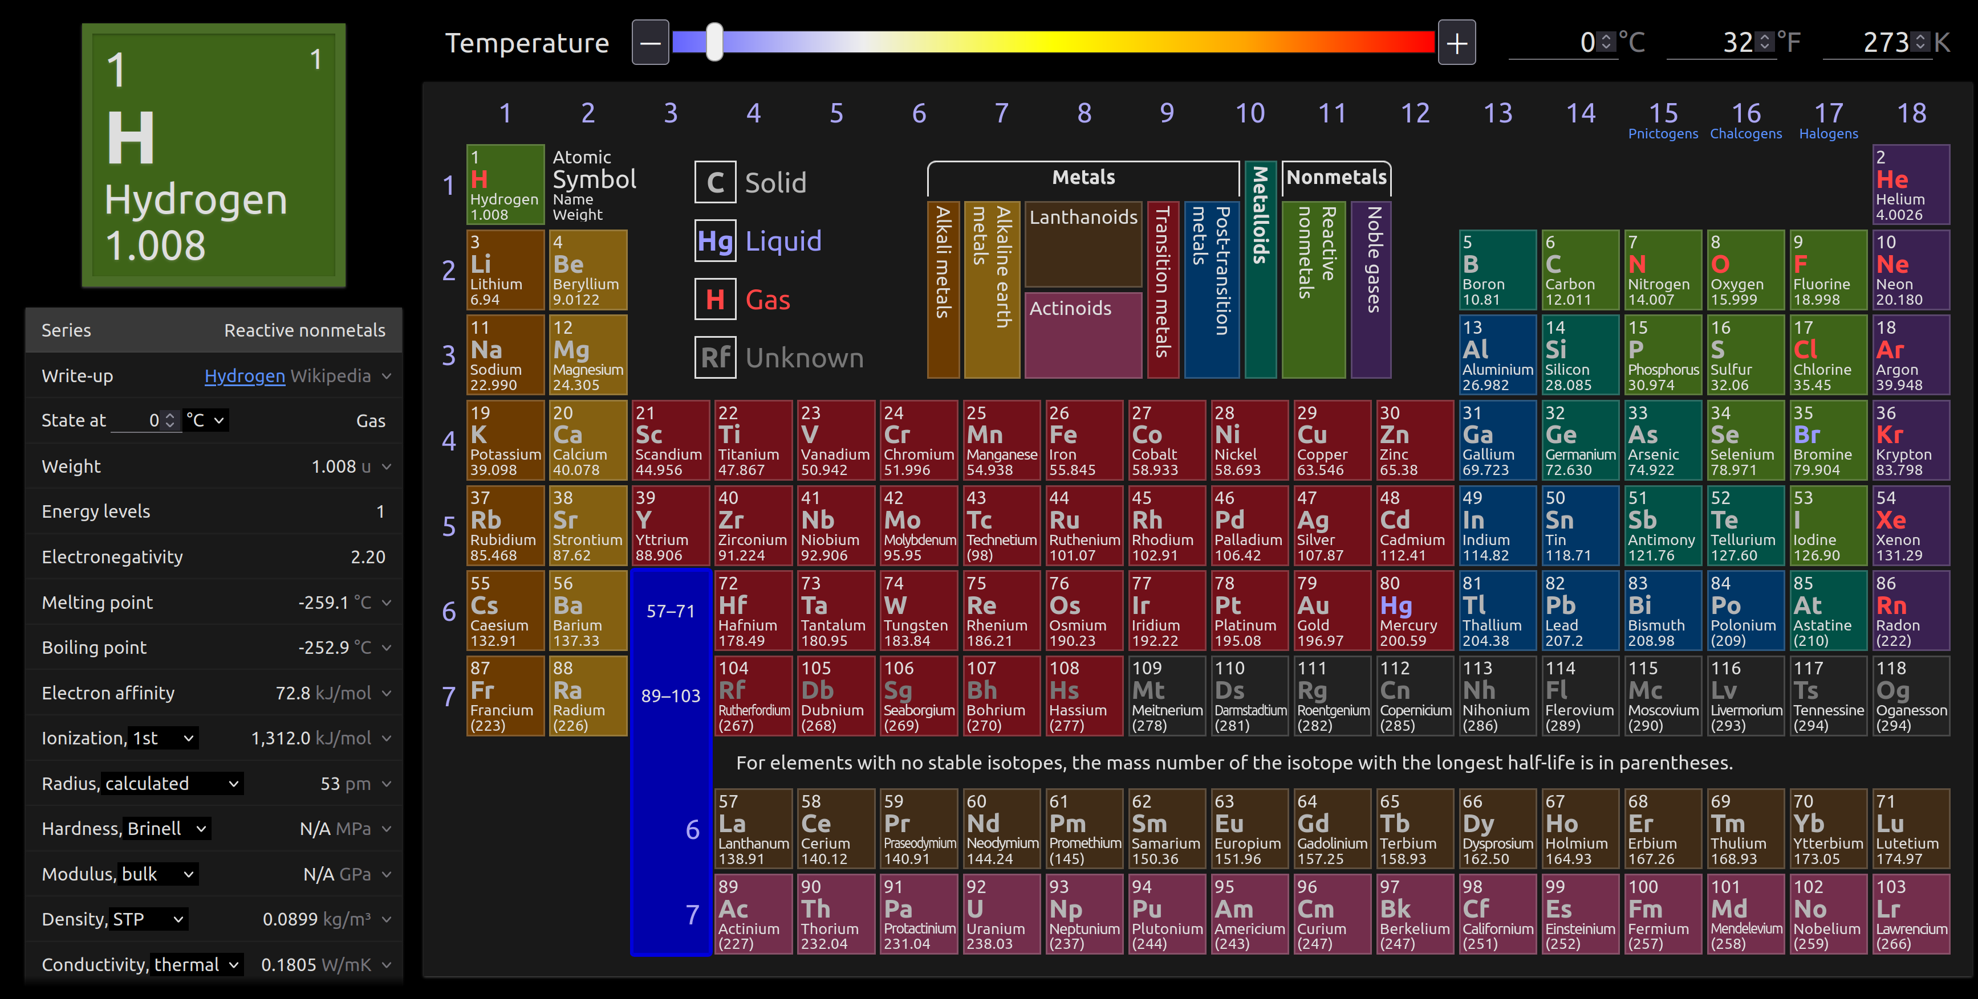
Periodic Table – Use ptable.com

Slide 21
Properties of matter
Physical Properties – identification of the substance such as texture, color, conductivity, melting point, boiling point, etc.
Extensive – depends on the quantity like mass (g)
Intensive – independent of the quantity like density (g/mL)

Slide 22
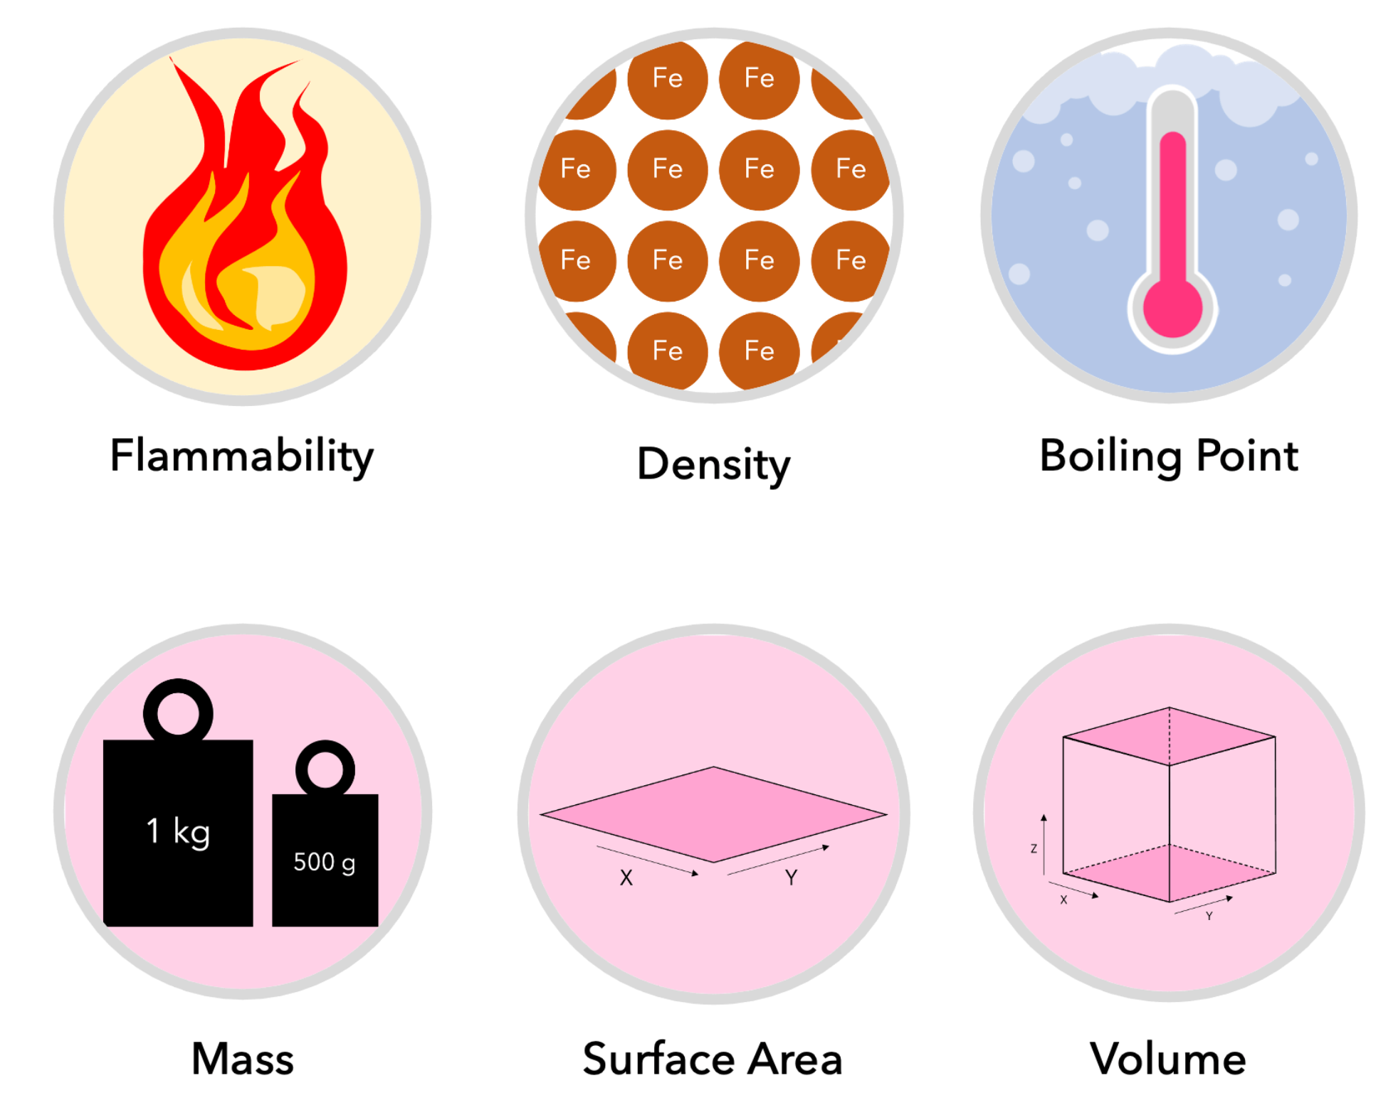
Q: Determine the following as extensive or intensive properties

Slide 23
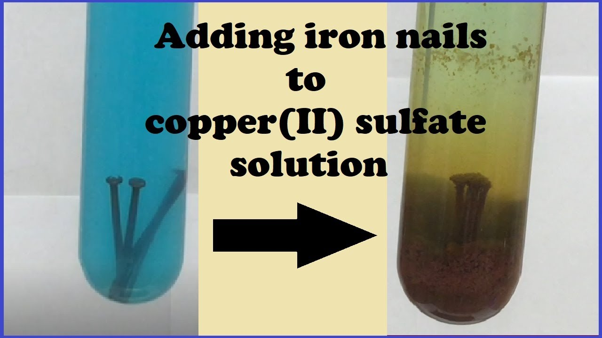
Properties of matter
Chemical properties – characteristics how the substance undergo reactions
Combustion reaction
https://www.youtube.com/watch?v=Z2llRM6UYlU
Oxidation Reduction reaction

Slide 24
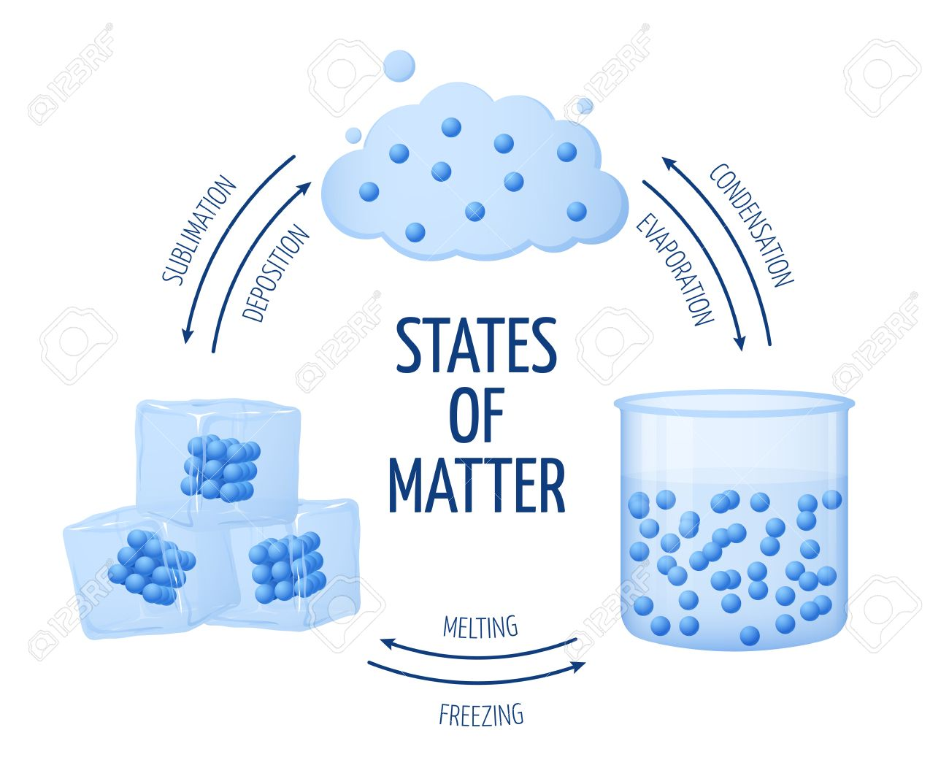

Physical and Chemical Changes
Physical change – does not alter the chemical composition
Chemical change – changes the chemical composition by breaking and reforming bonds
C_{x}H_{y}(g) + α O₂ (g) --> β CO₂ (g) + γ H₂O (g)

Slide 25
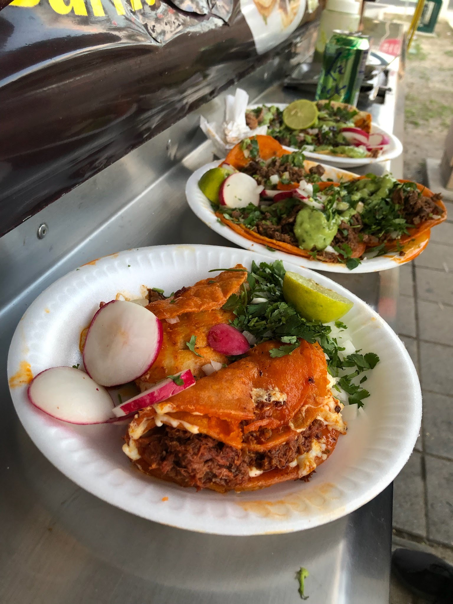
Q: Determine the following as physical or chemical change.
Chopping up carrots for a soup
Crisping corn tortillas for enchilado tacos
Dissolving sugar with water
Creating metal alloys (combination of two or more metals)
Heating sugar to form caramel
Digesting food
Charging your phone battery

Slide 26
Outline
Introductions: Who Am I? And teaching philosophy
Review Syllabus
Calculator Use and Scientific Notation
Ch. 1: Science and Measurements
Classification and properties of Matter
Scientific Method – hypotheses, theories, and laws
Significant Digits
Dimensional Analysis

Slide 27
The Scientific method
Universal tool for all scientific disciplines
Claim: Applicable to everyday life
How do I use the scientific method?
Gather observations – Qualitative (color, texture, temperature, etc.) and quantitative (measurable observable e.g. length and mass)
Generate hypothesis – Initial explanation for a phenomena
Test the hypothesis – gather data and observations
Determine whether to accept or reject hypothesis
If hypothesis is rejected, then reformulate the hypothesis (step 2)

Slide 28
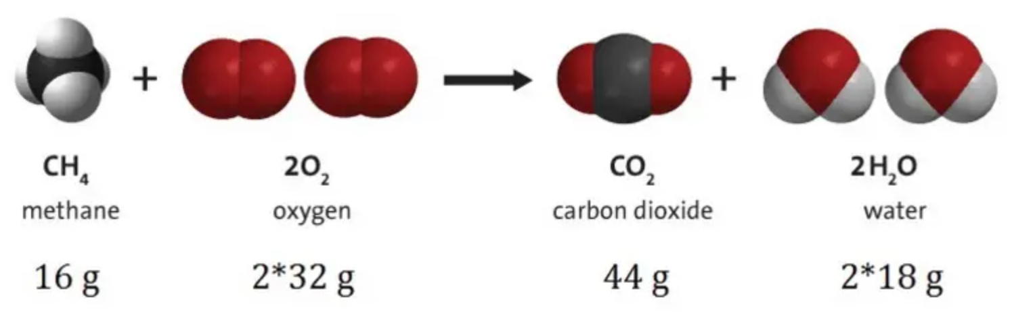
Hypothesis, theories, and laws
Hypothesis – An initial explanation of observations and is intended to be tested
Theory – After multiple repeated experimentations, hypothesis become a theory that is broader in scope and explains+predicts many observations
Law - Scientific observations (not explanations) that are always seen to be that way, with no exceptions e.g. Law of Conservation of Mass

Slide 29
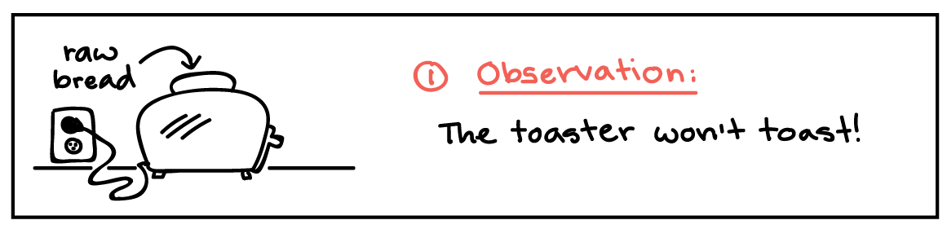

Scientific method: toaster problem

Slide 30

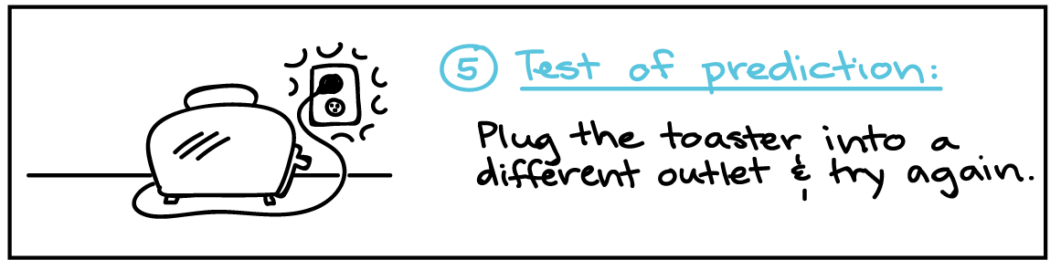
Scientific method: toaster problem

Slide 31
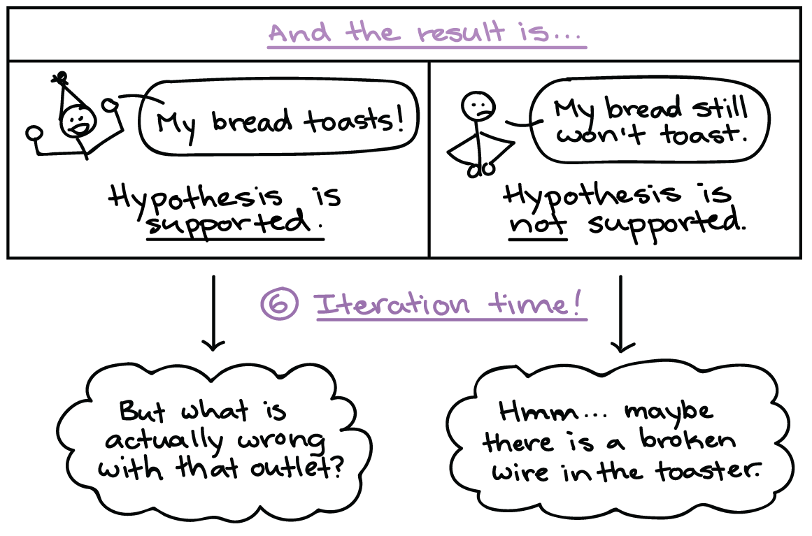
Scientific method: toaster problem

Slide 32
Your turn: apply scientific method to an everyday experience
Discuss with your neighbor and on a separate piece of paper, each write down an example of applying the scientific method to an everyday experience
Write your name and the collaborator(s')/neighbor(s') name
Pass the paper to the middle aisle and then forward to the front of the room (2 points in homework for completion)

Slide 33
Outline
Introductions: Who Am I? And teaching philosophy
Review Syllabus
Calculator Use and Scientific Notation
Ch. 1: Science and Measurements
Classification and properties of Matter
Scientific Method – hypotheses, theories, and laws
Significant Digits
Dimensional Analysis

Slide 34
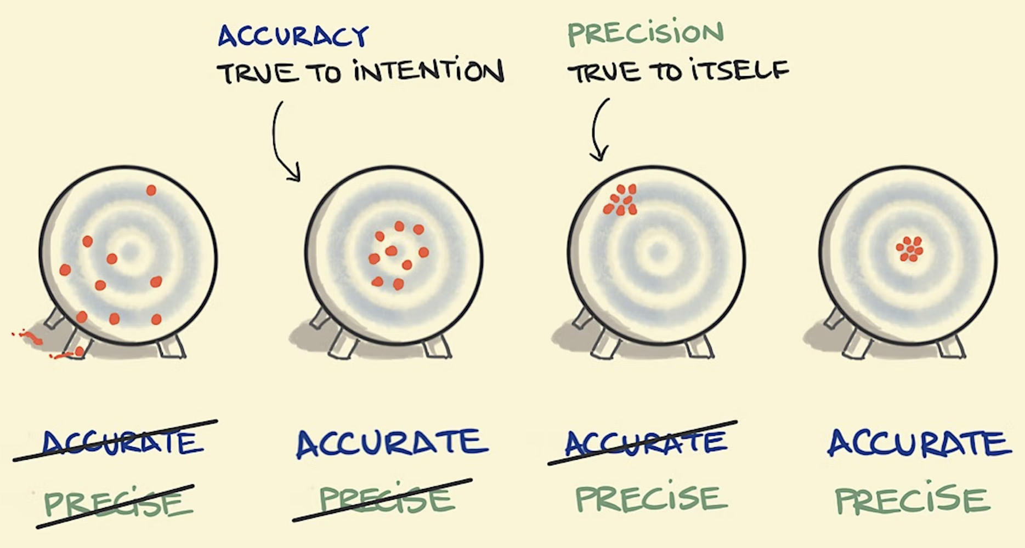
Significant digits
Recall qualitative and quantitative observations/data
Important when performing measurements. Implies a degree of accuracy and precision of the tool

Slide 35
Rules for significant digits
All nonzero digits are significant e.g. 1,039 has 4 signficant figures
Leading zeros such as 0.003, 0.01, etc are not significant
Sandwiched zeros – zeros between significant digits are significant e.g. 1,003
Trailing zeros – zeros to the right of all nonzero digits in a number are not significant unless there is a decimal e.g. 70,000 vs 70,000.
All digits in the coefficient of a number in scientific notation are significant

Slide 36
Sig. Figs.: addition and subtraction Rule
When adding or subtracting numbers, round the results to the fewest digit after the decimal based on the numbers being added or subtracted
Example:
6.2 cm + 9.203 cm = 15.4|03 cm = 15.4 cm
Side note: Importance of Units

Slide 37
Sig. Figs.: Multiplication and division rules
For multiplication and division, round the result based on the fewest significant figure based on the numbers being multiplied or divided
Example:
1.27 cm x 6.220 cm x 4.1 cm = 32.|38754 cm³ = 32 cm³

